Slide 1
No More Heroes: Why Team Composition is a BIG Deal
DevOpsDays Warsaw 2024
Pedro Ivo Raimundo – Cloud Engineering Manager

Slide 2
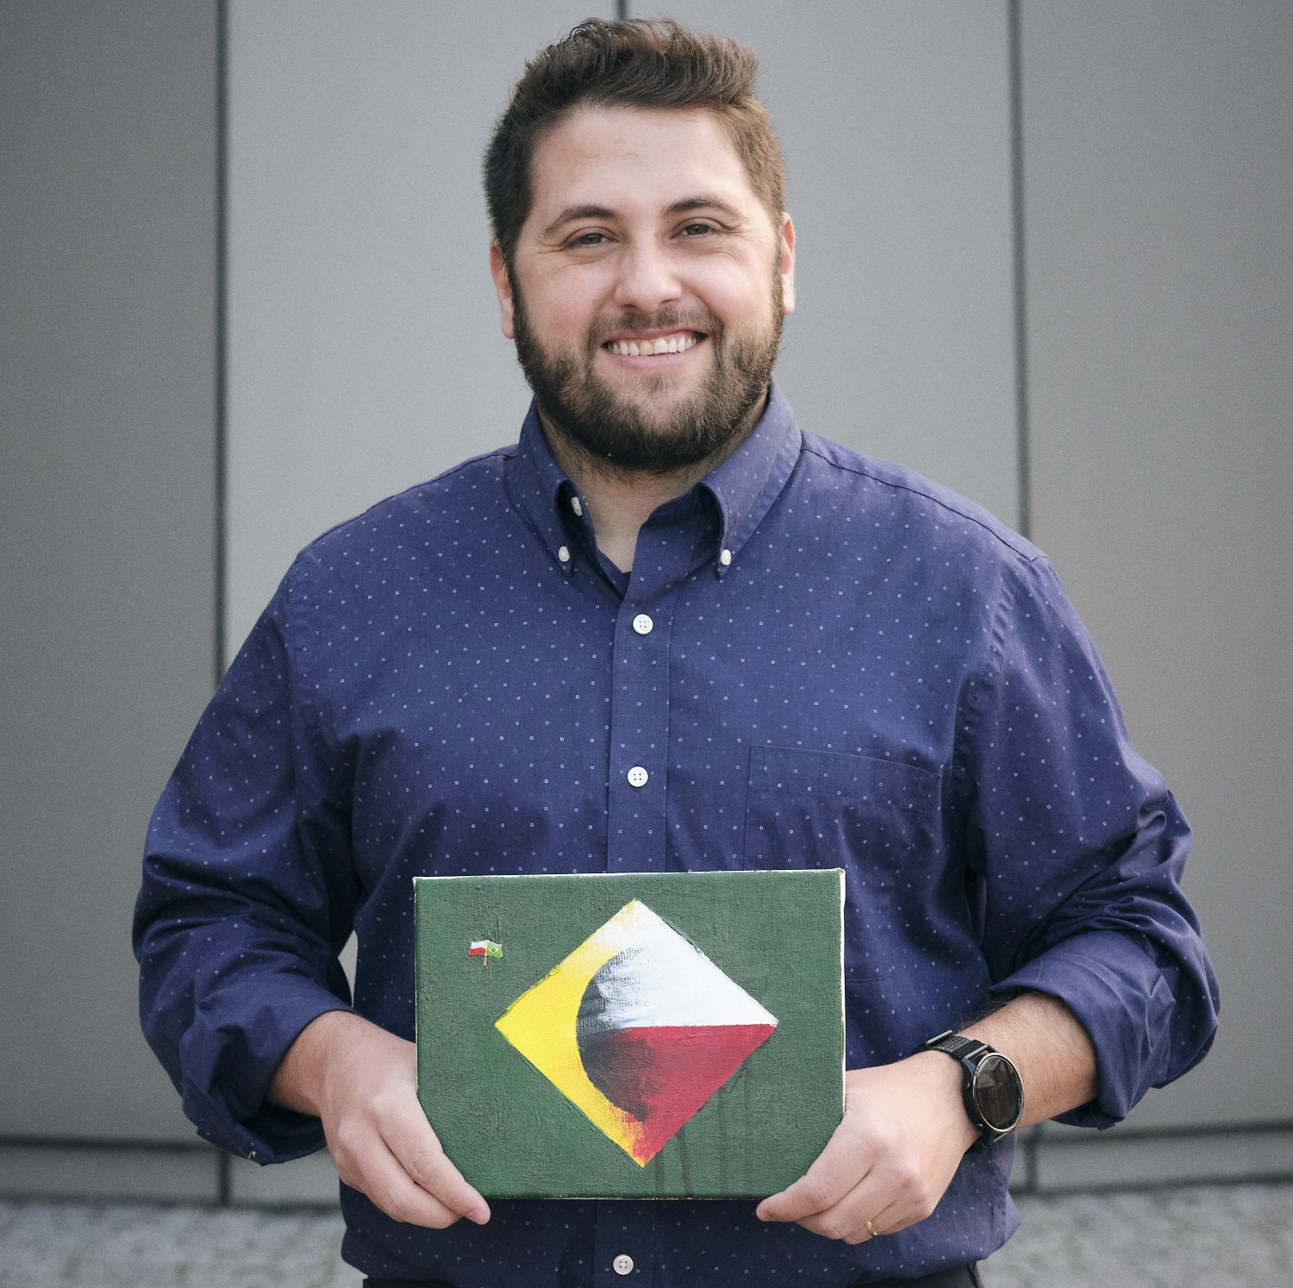

$ whoami
Pedro Ivo Raimundo
Fun facts that absolutely nobody asked for:
Cloud Engineering Manager @
Support/Ops > DevOps > Leadership
6 years in Poland and loving it 🇵🇱❤️
Favorite Polish word
Pedro Iwo Chajmóndo (po Polsku)
Intro

Slide 3

About Pega
Enterprise AI decisioning and workflow automation
Pega Cloud (SaaS offering)
Awesome place to work ☺
Check us out! (QR code)
Intro

Slide 4
Why should you care about TEAM COMPOSITION?
…bingo edition!

Slide 5
Bingo
Waited hours or even days for a different team to unblock your work/deliverable in some way
+1
Problem

Slide 6
Bingo
Had to save the day by fixing something very urgently (possibly during a coffee-fuelled rage at crazy hours or doing significant overtime)
+1
Problem

Slide 7
Bingo
Got redirected to a different teams/people multiple times under the same e-mail thread
+1
Problem

Slide 8
Bingo
Gets multiple emails/alerts/msgs per day with no value, meaningful information or action required from you
+1
Problem

Slide 9
Bingo Results
Problem

Slide 10
Bingo Results
0: You don’t work with IT
¯\_(ツ)_/¯
Problem

Slide 11
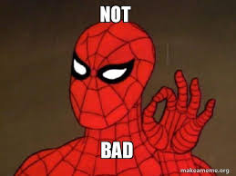
Bingo Results
1-2:
Problem

Slide 12

Bingo Results
3-4:
Problem

Slide 13
Studies
Study on Open Source Projects (2006):
Summary: Research on open-source projects found that when the developers’ communication patterns matched the software architecture, the projects were more successful and had fewer bugs.^{[2]}
Harvard Business Review Article (2012):
Summary: The article discusses how software and organizational architectures align, using examples from various tech companies to show that mismatches can lead to inefficiencies and integration issues. ^{[1]}
Problem

Slide 14
Summarizing the Problem(s)
The lack of planning to compose teams may cause:
Dependency bottlenecks
Communication gaps
High Cognitive Load
Inconsistent Practices
Scope Creep
Skill Gaps
Technical Debt
Siloed Information
Lack of Autonomy
Misaligned Goals
And all of that causes
FRUSTRATION!
Problem

Slide 15
Summarizing the Problem(s)
So… what explains that?
Problem

Slide 16
Before we dive into this rabbit hole
Team Composition definition (for this presentation's sake):
Macro: Organizing teams within an organization
(team-team interaction)
Micro: Interaction of individuals inside a team (people interaction)
Problem

Slide 17

Starting with Mario Macro: Lette go!
Macro

Slide 18
Conway’s Law
Macro

Slide 19
Macro: Conway’s Law (definition)
“Any organization that designs a system will produce a design whose structure is a copy of the organization's communication structure.”^{[3]}
(Melvin Conway, 1967)
Macro

Slide 20
Macro: Conway’s Law (definition)
"If you have four groups working on a compiler, you'll get a 4-pass compiler.”^{[4]}
(Eric S. Raymond, 1996)
Macro

Slide 21
Macro: Conway’s Law (in action)
Goal: Prepare a Birthday Party
Setup:
Team 1: Cake
Team 2: Music
Team 3: Decoration
Challenge: Team members live far away from each other and have little time to prepare
Macro

Slide 22
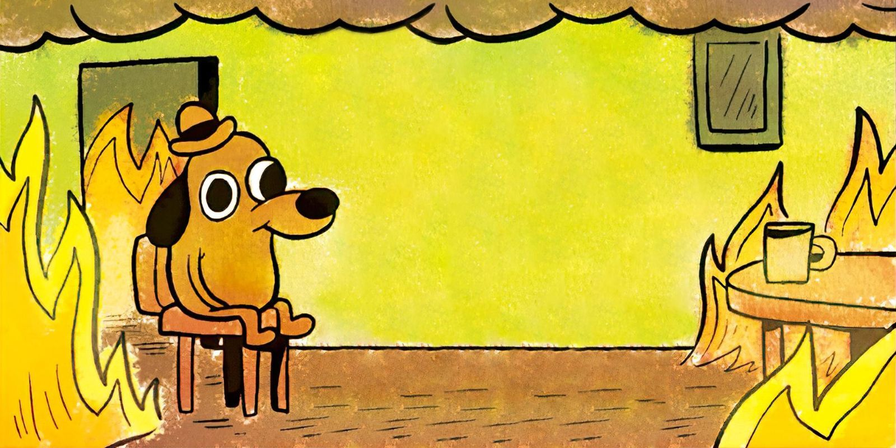
Macro: Conway’s Law (in action)
Scenario 1: Chaos
Macro

Slide 23

Macro: Conway’s Law (in action)
Team 1: Runs to a local shop they know has good quality and best cake practices.
They get offered a discount on a “jungle-themed” cake and decide the price/quality ratio is great (good investment price)
Macro

Slide 24

Macro: Conway’s Law (in action)
Team 2: Prepares a playlist with country songs, because their research pointed that 60% of attendees enjoy this music genre (research your user)
Macro

Slide 25

Macro: Conway’s Law (in action)
- Team 3: Decorates the party with rockets and astronauts, because they had some decor remaining from last year, which would save them time (reutilization, cost/time saving)
Macro

Slide 26
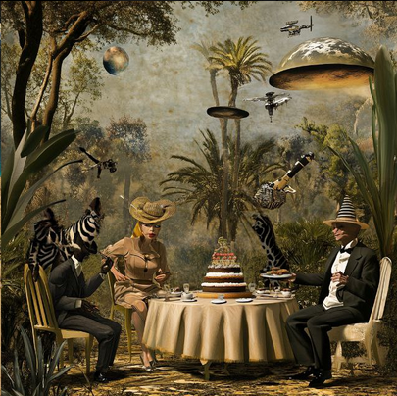
Macro: Conway’s Law (measuring results)
The party:
Macro

Slide 27
Macro: Conway’s Law (measuring results)
RCA for Scenario 1:
”Path of least resistance” org distribution:
Teams got selected without any strategy or planning
No correlation between team structure and desired architecture
Siloed information and decision making:
Teams took best decisions… for their own goals
Information was never exchanged
No common architecture or end goal was defined for all teams
Macro

Slide 28

Macro: Conway’s Law (in action)
Scenario 2: Fixing it
Macro

Slide 29
Macro: Conway’s Law (applying it)
After this weird “Tarzan meets Cowboy Bebop“ party, the next year the team decides to apply what we call:
The Inverse-Conway-Maneuver (ICM)
Macro

Slide 30
Macro: Conway’s Law (applying it)
“The Inverse Conway Maneuver (ICM) is a strategy where an organization intentionally designs its team structure to achieve a desired system architecture”
in other words..
“Organizations should evolve their team and organizational structure to achieve a desired architecture”^{[5]}
Macro

Slide 31
Macro: Conway’s Law (applying it)
The next year…
All Teams:
Meet and agree to a common party theme based on data
Separate teams based on desired outcomes
Plan short feedback touchpoints between teams
New teams:
Team 1: Cake and Decorations
Team 2: Music and Entertainment
Macro

Slide 32

Macro: Conway’s Law (applying it)
Team 1: Based on the data shared by the “Music and Entertainment” team about the attendees’ musical preference, they go to the local shop and ask for a country-themed cake.
In the same place, they find matching themed decor and strike a deal.
Macro

Slide 33
Macro: Conway’s Law (applying it)
Team 2: After review from the ”Cake and Decor” team, they remove songs from the playlist that were not appropriate for the party (there will be children there!)
Based on that exchange, they also add a “police & bandits” activity for the kids.
Macro

Slide 34
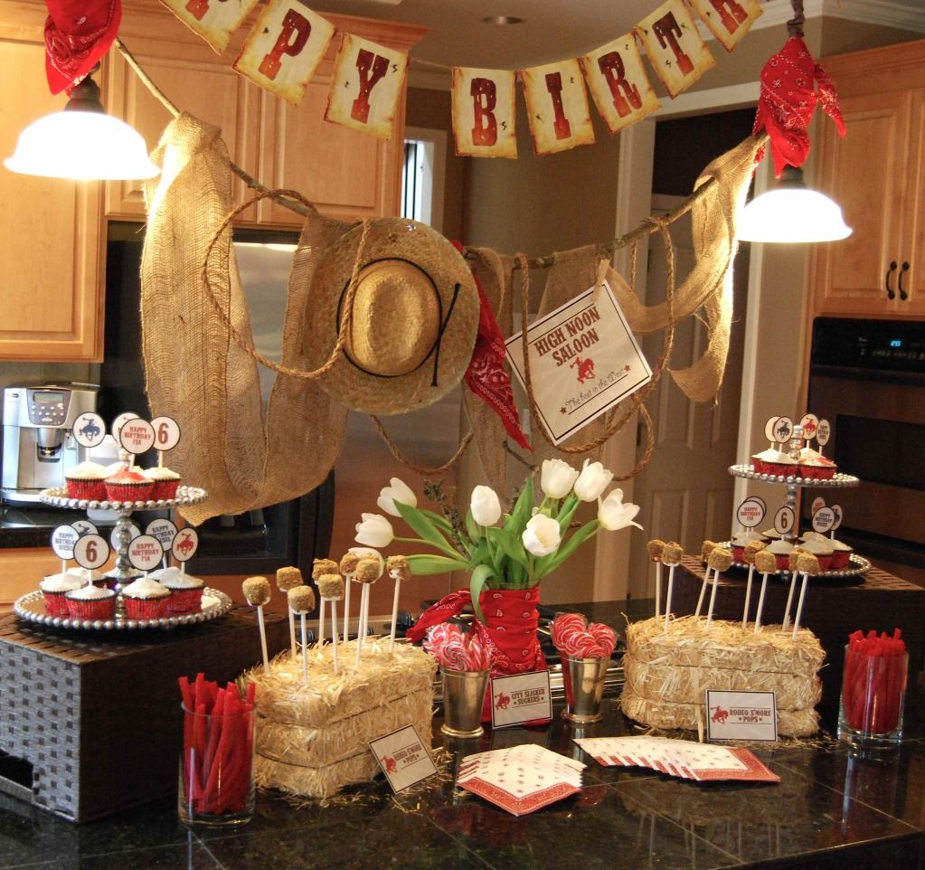
Macro: Conway’s Law (applying it)
Result:
Macro

Slide 35
Macro: Conway’s Law (takeaway)
“The first step in dealing with Conway's Law is know not to fight it.”^{[6]}
(Martin Fowler, 2022)
Macro

Slide 36
Macro: Breaking down team roles
How does that silly story translate to a real-world scenario?
Macro

Slide 37
Macro: Breaking down team roles
Typically, dev teams are separated by function:
Frontend, Backend, DB, QA, Ops, Support, etc…
Or sometimes by component/feature:
Search Engine, Authentication, Logging and Monitoring, etc…
Macro

Slide 38
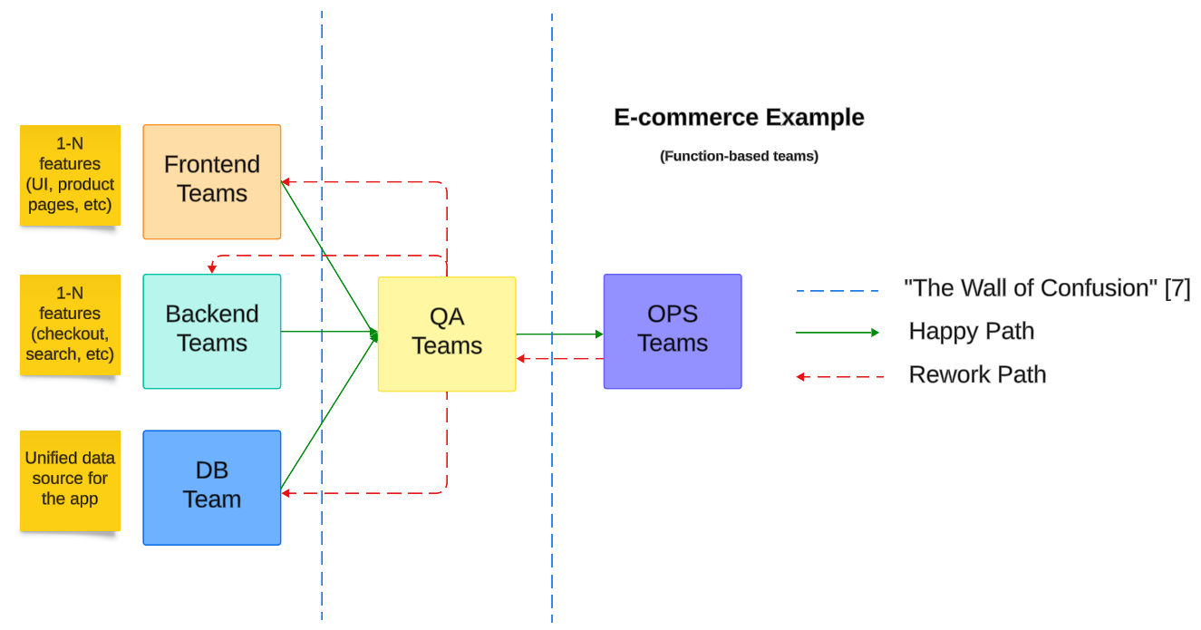
Macro: Breaking down team roles
Macro

Slide 39
Macro: Breaking down team roles
According to ”Team Topologies”^{[8]} there are four fundamental types of teams:
Stream-Aligned Teams
Enabling Teams
Complicated Subsystem Teams
Platform Teams (rings a bell, DevEx folks? ☺)
Macro

Slide 40
Macro: Stream-Aligned Teams
A stream-aligned team is assigned to a specific flow of work, fully responsible for delivering customer value.
✅ End-to-end ownership (autonomy focused)
✅ Cross-functional (including roles such as devs, testers, POs, etc) -> Hybrid Heroes! ☺
✅ Focused on outcomes (that can delivered via a product, a ”journey”, etc…)
Macro

Slide 41
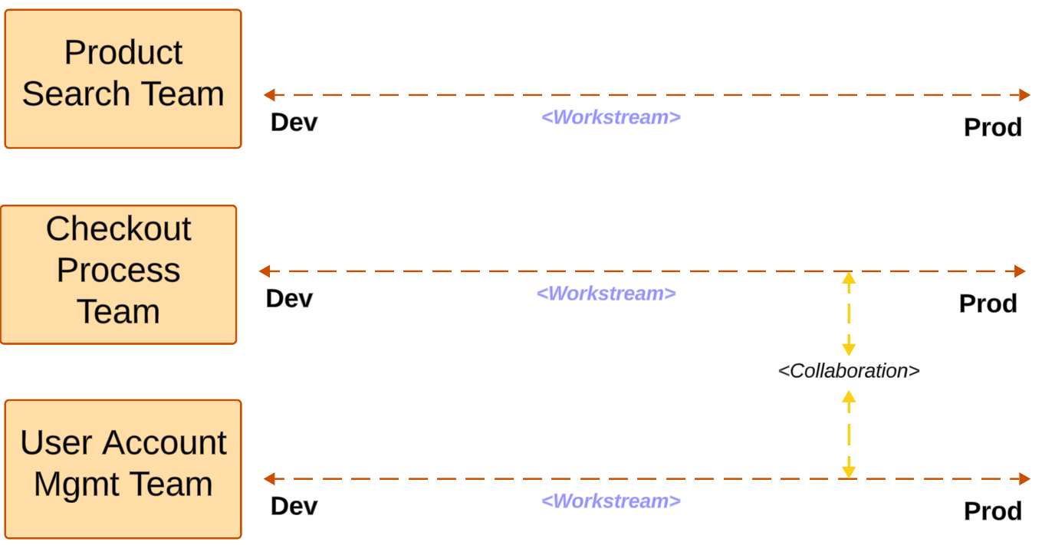
Macro: Stream-Aligned Teams
Macro

Slide 42
Macro: Enabling Teams
An enabling team assists teams by spreading knowledge, tools, and best practices.
Act as “internal consultants”, helping teams to adopt new technologies and methodologies.
✅ Serve to speed-up enablement (specially stream-aligned teams)
✅ Help reduce cognitive load
✅ Dynamically assigned based on specific goals/challenges
Macro

Slide 43
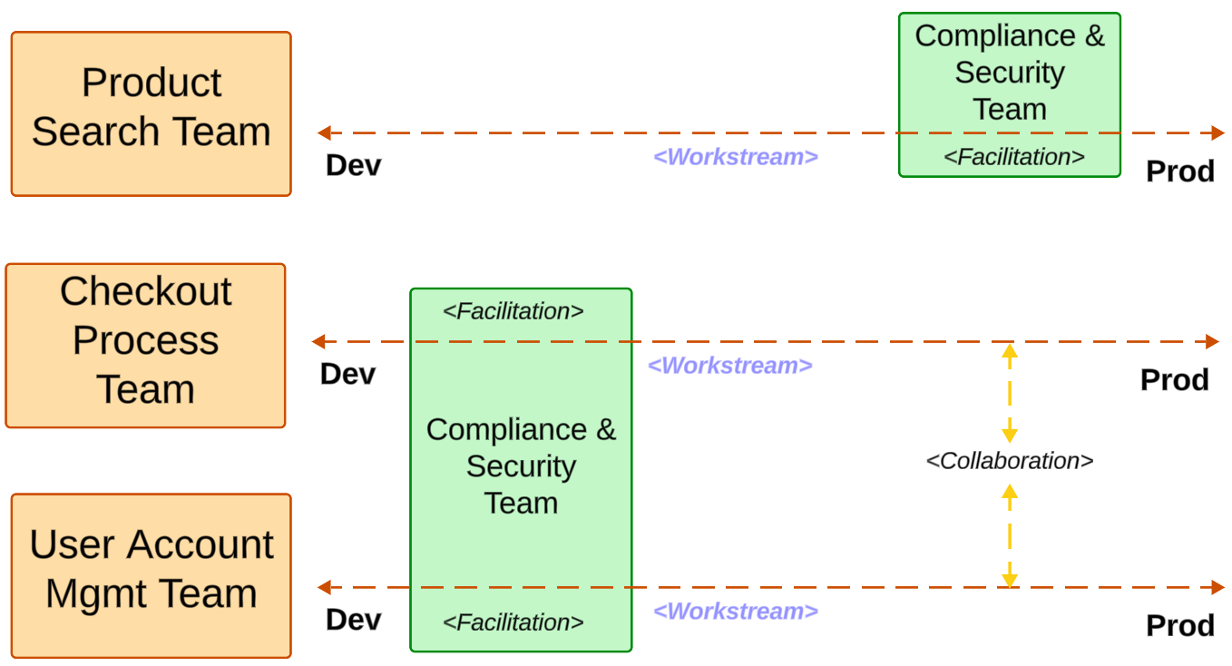
Macro: Enabling Teams
Macro

Slide 44
Macro: Complicated Subsytem Teams
A complicated subsystem team is responsible for a part of the system that requires specialized knowledge.
Examples: complex algorithms, highly technical components or specific domains.
✅ Formed by subject matter experts (SMEs)
✅ Focused on complex problem solving
✅ Help reduce cognitive load (teams can offload specialized work to CSTs)
Macro

Slide 45
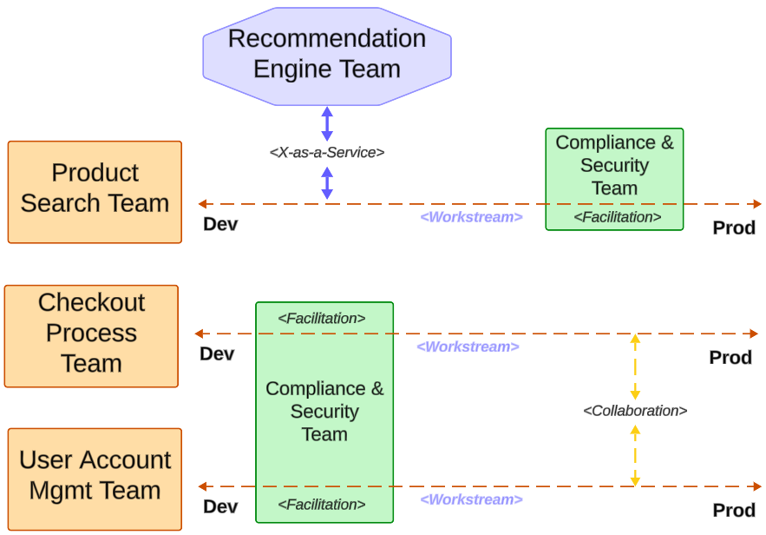
Macro: Complicated Subsytem Teams
Macro

Slide 46
Macro: Platform Teams
A platform team provides internal services and platforms to accelerate delivery by Stream-Aligned Teams.
The focus is creating reusable infrastructure, reducing cognitive load on other teams.
✅ Automation and reusability focused
✅ Delivering an amazing DevEx is the goal
✅ Help reduce cognitive load (teams use platform team’s solutions to accelerate)
Macro

Slide 47
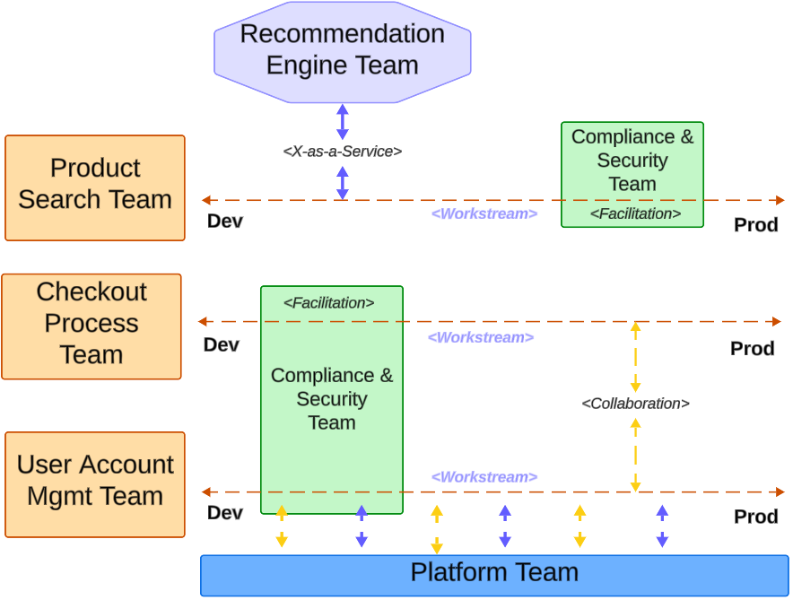
Macro: Platform Teams

Slide 48
Macro: Team Interaction Modes
Let’s once more refer to ”Team Topologies”^{[8]} about types of existing team interaction modes:
Collaboration
Facilitation
X-as-a-service
Macro

Slide 49
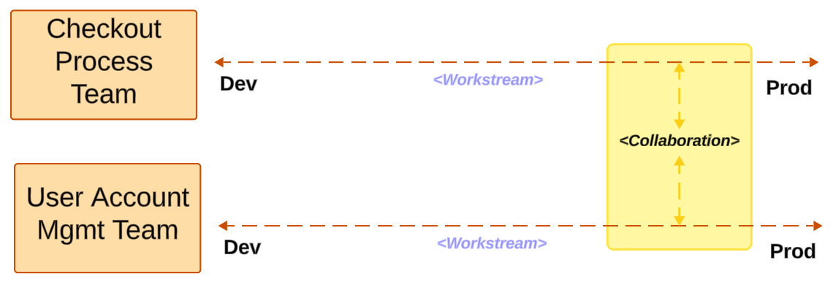
Macro: Team Interaction Modes: Collaboration
During “Collaboration” interactions, teams:
✅ Discovery phase for new technologies, tools, APIs
✅ Common problem solving, work on synergy areas
Our example: CPT team collaborates with UAMT team to work on a new automatic checkout feature, where data is auto-populated upon checkout
Macro

Slide 50
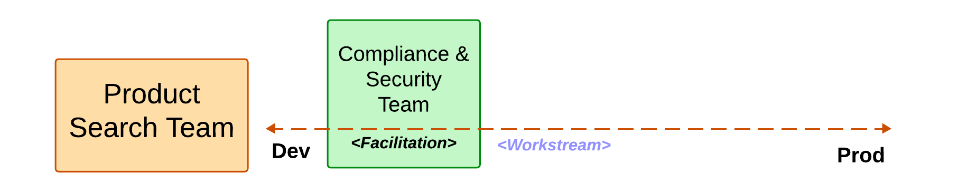
Macro: Team Interaction Modes: Facilitation
During “Facilitation” interactions, teams:
✅ Enablement type teams provide mentorship/consultancy/partnership with other teams
✅ There’s no product ownership on the enablement team
✅ One way road: Team A helps enable Team B
Our example: CST team guides the search team on applying processes to safely store user’s search data according to security best practices from dev start
Macro

Slide 51
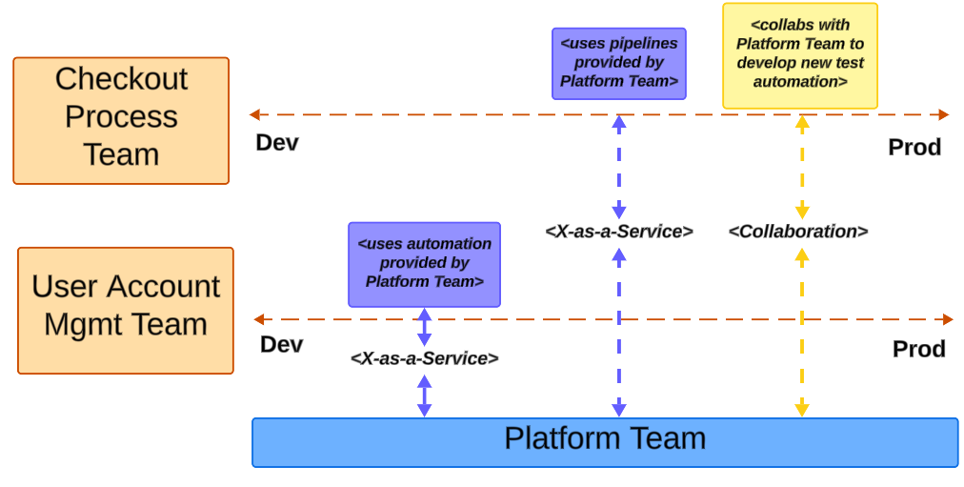
Macro: Team Interaction Modes: X-as-a-Service
During “X-as-a-service” interactions, teams:
✅ Provides a service-like solution that can be consumed
✅ Collaboration and X-as-a-service can coexist
Our example: Platform team provides automation/pipelines to other Stream-aligned teams
Macro

Slide 52

Micro: How does all of that affect me?
To understand how that impacts you, it is time to get micro!
Micro

Slide 53
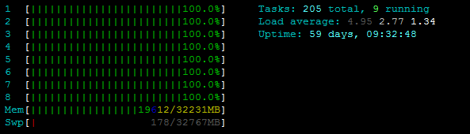
Micro: Cognitive Load
Cognitive Load refers to the total amount of mental effort being used in the working memory.
As a developer, cognitive load is your “CPU Brain capacity” to manage multiple activities at the same time (coding, managing tools, requirements, and sometimes even talking to other people)
(Dev’s brain after committing a small hotfix on prod, Friday)
Micro

Slide 54

Micro: Cognitive Load (The Hero Antipattern)
Micro

Slide 55

Micro: The Hero Antipattern
Let’s define HERO for this context
Sometimes, being a hero is a good thing:
Micro

Slide 56
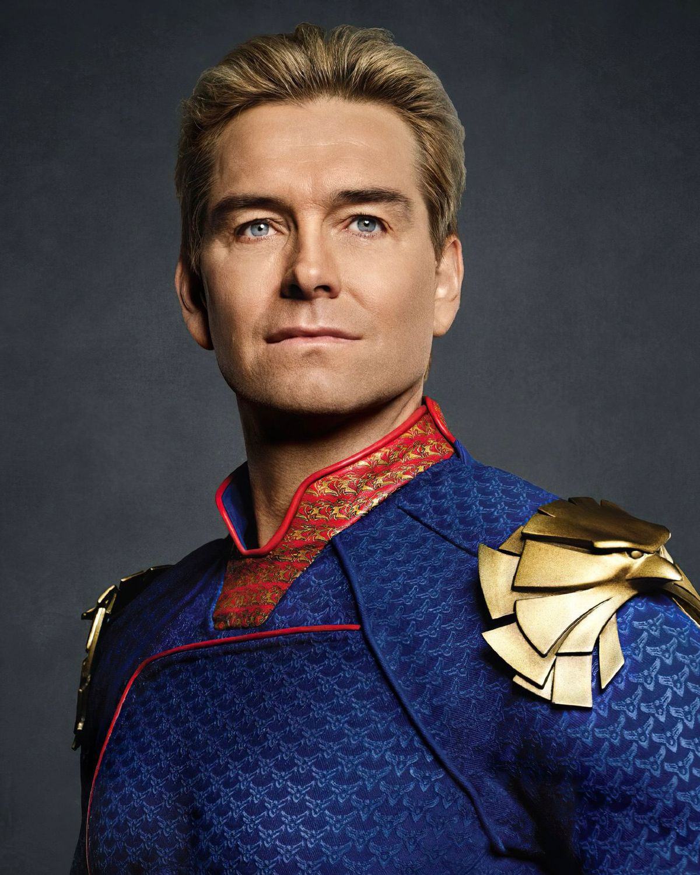
Micro: The Hero Antipattern
Let’s define HERO for this context
And sometimes… not ☺
Micro

Slide 57
Micro: The Hero Antipattern
When it comes to the anti-pattern, a Hero:
Spend most of the time working under very high cognitive load
Has no time to do other things outside of urgent business needs
Are more susceptible to suffer from stress, burnout and work longer hours
Usually can’t cooperate effectively (they are busy saving prod)
Due to their reputation, they will be often requested, perpetuating the cycle (imbalanced work distribution)
Tend to leave their current company on long term (sometime IT altogether)
Micro

Slide 58
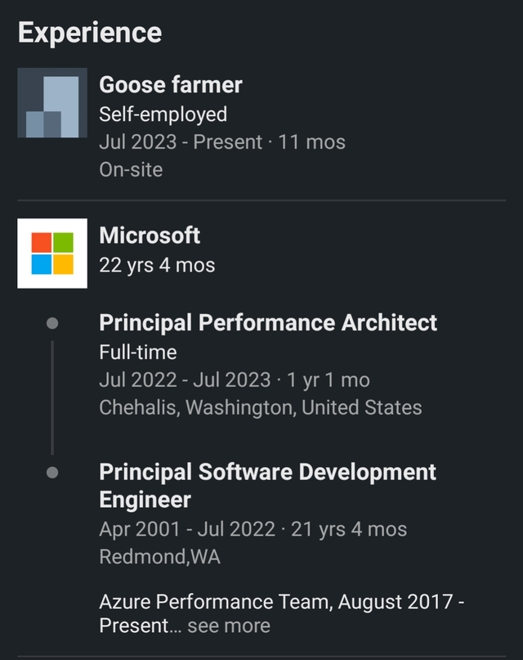
Micro: The Hero Antipattern
Micro

Slide 59
Micro: The Hero Antipattern
To avoid letting a hero live enough to become a goose farmer:
Well distributed and well scoped teams
Using the help of Platform and Complicated Subsystems teams
Ensuring teams have enough autonomy and ownership
Properly distributing work among team members (good team composition)
Not releasing on Friday ☺
Micro

Slide 60
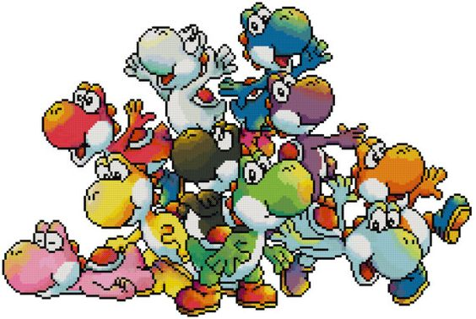
Micro: How do I apply all this findings?
Now let’s talk about how to apply those principles when building teams!
Micro

Slide 61

Micro: Dunbar’s Number
The theoretical cognitive limit of people a human can maintain a stable relationship with is around ^{[9]} ~150 people
Micro

Slide 62
Micro: Dunbar’s Number
The number itself is not the key takeaway, but rather the underlying principles we apply when creating dev teams:
Cognitive Load Management: Keeping team sizes manageable to prevent cognitive overload.
Efficient Communication: Smaller teams facilitate better communication
Team Boundaries: Clear team boundaries and responsibilities
Cultural Cohesion: Smaller teams foster stronger interpersonal connections
Micro

Slide 63
Micro: 2x Pizzas Team
„A team should be small enough that it can be fed by with 2x pizzas” ^{[10]}
(Jeff Bezos, circa 2000)
But remember… the number of members is not the sole and most important factor!
Micro

Slide 64
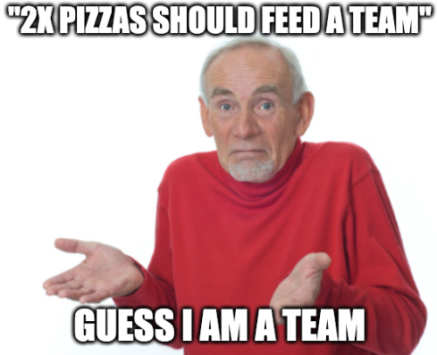
Micro

Slide 65
Actions:
What can I do about that (as a leader)?
Go deeper into Conway’s Law and its implications
Experiment with your team/org (micro AND macro)
Advocate to higher management about the importance
Rethink how to plan for outcomes
Books, e-books, audiobooks! (recommendations in last slides)
Takeaways

Slide 66
Actions:
What can I do about that (as a dev)?
Inform, influence, speak up
As a senior, stretch your soft skills
Join the interview process for new joiners
Think about ownership as resolving problems, not simply creating features
Try temporary rotations, internal movements, new experiences
Takeaways

Slide 67
Takeaways:
Team Composion is EXTREMELY context-specific (no silver-bullet)
Conway’s Law WORKS. Period.
Be intentional and thoughtful when introducing team changes
Consider how teams interact in your organization – MAP IT!
Look for bottlenecks (“Any time spent on non-bottleneck activities is wasted time.”^{[10]})
Takeaways

Slide 68
Sources:
[1]: Baldwin, C. Y., & Clark, K. B. (2012). “The Architecture of Participation: Does Code Architecture Mitigate Free Riding in the Open Source Development Model?” Harvard Business Review.
[2]: Cataldo, M., Wagstrom, P., Herbsleb, J. D., & Carley, K. M. (2006). “Identification of coordination requirements: implications for the Design of collaboration and awareness tools”. CSCW '06.
[3]: Conway, Melvin E. (April 1968). "How do Committees Invent?". Datamation.
[4]: Raymond, Eric S. (October 1996). “The New Hacker's Dictionary (3rd ed.)”. Cambridge, Massachusetts: MIT Press. p. 124. ISBN 978-0-262-68092-9.
[5]: Forsgren, N. PhD, Humble, J., Kim, G., Bell, S., Whitley Bell, K. (2018). “Accelerate: The Science of Lean Software and DevOps: Building and Scaling High Performance Technology”, IT Revolution Press, 2018.
[6]: Fowler, M. (2022). “Conway's Law”. Thoughtworks. https://martinfowler.com
[7]: Shafer, A. (2009). “AgileRoots 2009 - Agile Infrastructure by: Andrew Shafer”. https://www.youtube.com/watch?v=Y_u84PNrX9g
[8]: Skelton, M., Pais, M. (2019). “Team Topologies: Organizing Business and Technology Teams for Fast Flow”. IT Revolution Press, 2019.
[9]: R.I.M. Dunbar (1992). “Neocortex size as a constraint on group size in primates”, Journal of Human Evolution, ISSN 0047-2484.
[10]: Bezos, J. (Circa 2000). Mentioned in “Powering Innovation and Speed with Amazon’s Two-Pizza Teams”. https://aws.amazon.com/executive-insights/content/amazon-two-pizza-team/
[11]: Cox, J., Goldratt, E. (1986). “The Goal” Theory of Constraints. North River Press. ISBN 978-0-88427-178-9.
Wrap-up

Slide 69
My recommended books on the topic:
Team Topologies: Organizing Business and Technology Teams for Fast Flow – by Manuel Pais and Matthew Skelton (2019) (https://teamtopologies.com/)
Dynamic Reteaming: The Art & Wisdom of Changing Teams - by Heidi Helfand (2018) (https://www.heidihelfand.com/dynamic-reteaming-book/)
EMPOWERED: Ordinary People, Extraordinary Products – by Marty Cagan and Chris Jones (2020) (https://www.svpg.com/books/)
The Five Dysfunctions of a Team: A Leadership Fable – by Patrick Lencioni (2002) (https://www.tablegroup.com/pat/#books)
Wrap-up

Slide 70

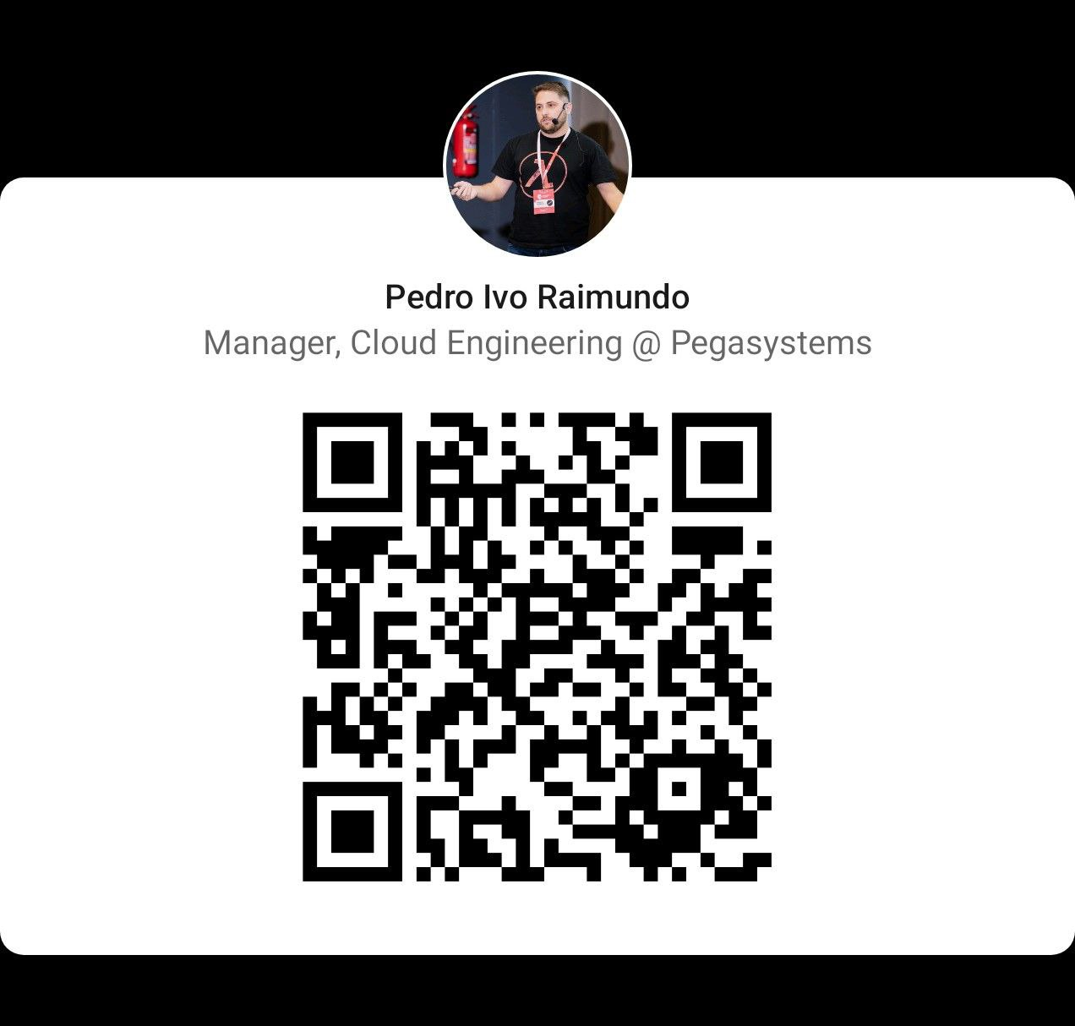
Thank you, dziękuję, obrigado! ☺
Git repo with slides
Wrap-up

